Slide 1
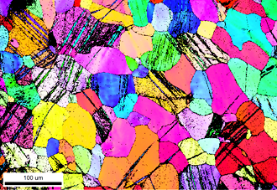
Effect of crystallographic texture on fatigue measurements of commercially pure titanium
Metallurgical Processes Laboratory
MSE313A

Slide 2
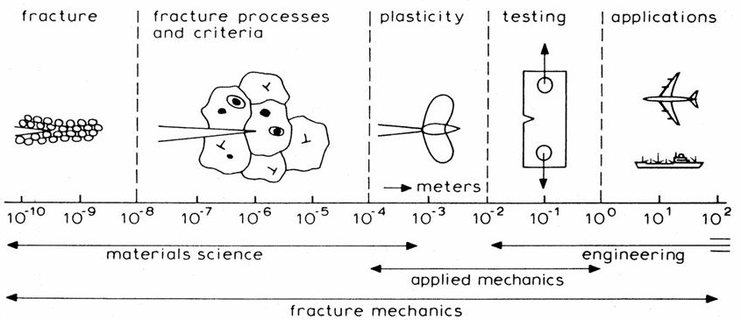
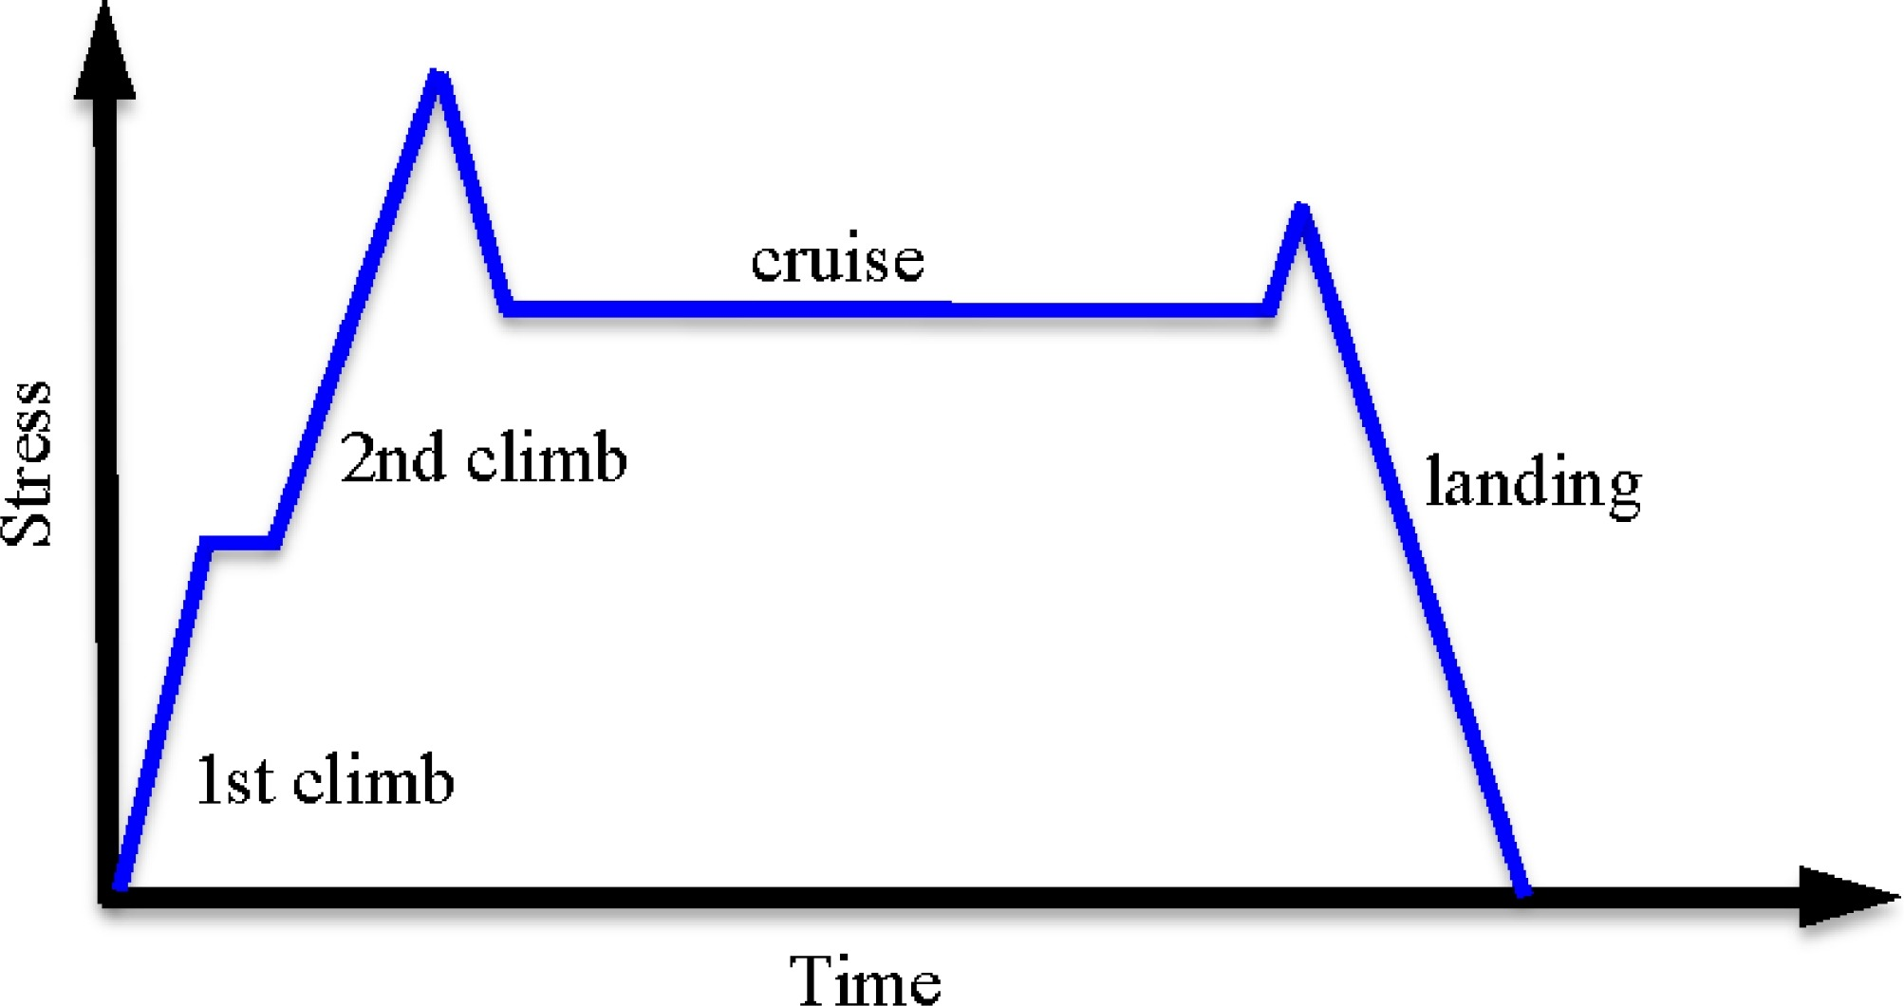
Fatigue and Dwell Fatigue
Fatigue is the process of crack initiation and growth leading to failure under cyclic loading. This has particular significance for structures which are typically lightweight, highly stressed and exposed to oscillatory and vibratory loads.
Dwell sensitivity in Ti (and its alloys) can be traced back to the early 1970s when cold dwell fatigue was first detected.
Why Dwell?
A significant reduction in fatigue life, termed dwell debit occurs if a stress dwell is included in the fatigue cycle
Schematic diagram of a single duty cycle for a gas turbine engine
Ref:
Ewalds & Wanhil

Slide 3
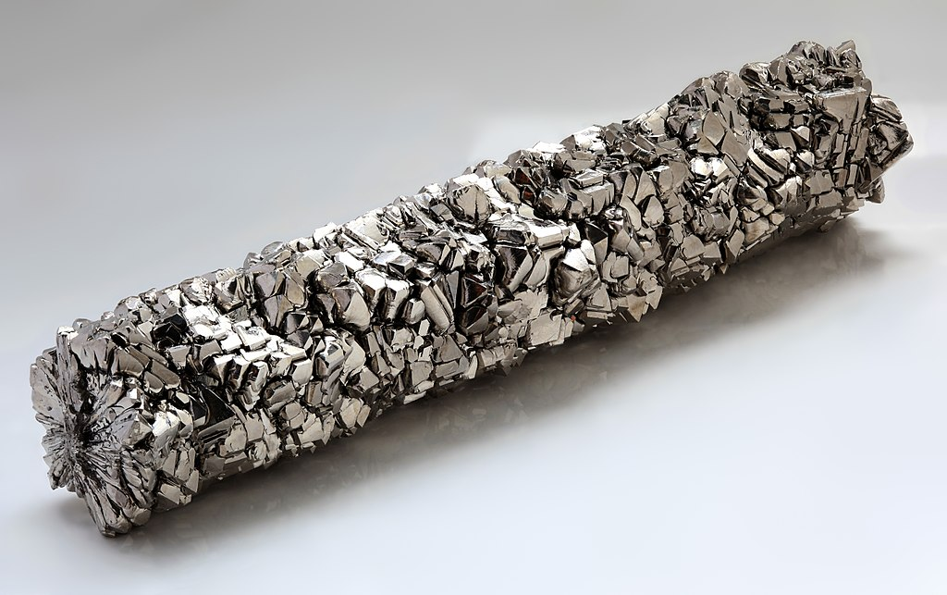

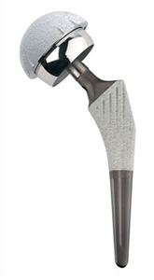
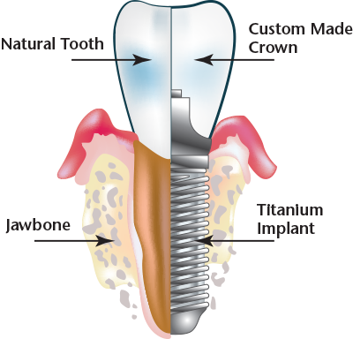
Titanium
It is a lustrous transition metal with a silver color, low density, and high strength.
The most useful properties:
Corrosion resistance
Highest strength-to-density ratio of any metallic element
High temperature performance
Industrial applications:
Aerospace industry
Airframe structures and jet engines
Pressure vessels
Heat exchangers and tubing
Biomedical applications
Dental implants
Metallic cups in knee and hip joint implants
Components are subjected to overloads, load reversals and cyclic loading
Ref:
https://www.designnews.com/aerospace/new-metal-alloys-are-shaking-aerospace/127595379246660
http://www.betterbitesbybusch.com/implants.php https://www.hagen-law.com/georgia-defective-hip-replacements/

Slide 4
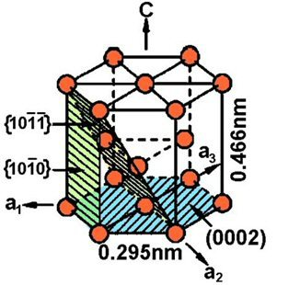
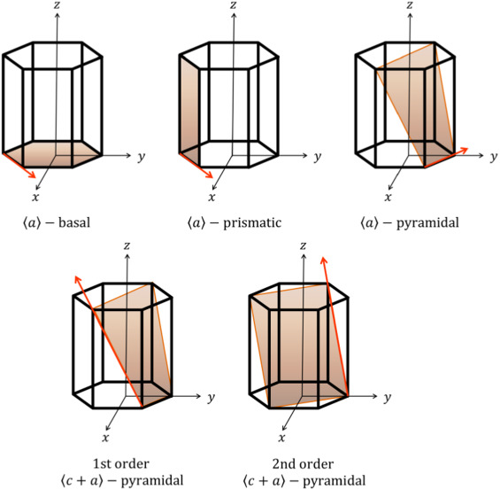
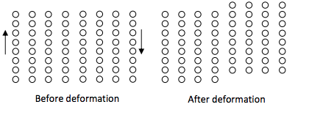
Titanium - Crystal Structure
Hexagonal Closed Packed
c/a ratio = 1.58 ( < 1.633)
Plastic deformation in polycrystals require five independent shear systems to accommodate strain tensor according to Von Mises criterion.
Most metals (FCC, BCC) need five independent slip systems on which resolved shear stress exceeds CRSS.
In HCP it is difficult to obtain five independent slip systems due to lower symmetry.
Ref:
https://doi.org/10.1016/0079-6425(94)00007-7 http://www.dierk-raabe.com/titanium-alloys/

Slide 5
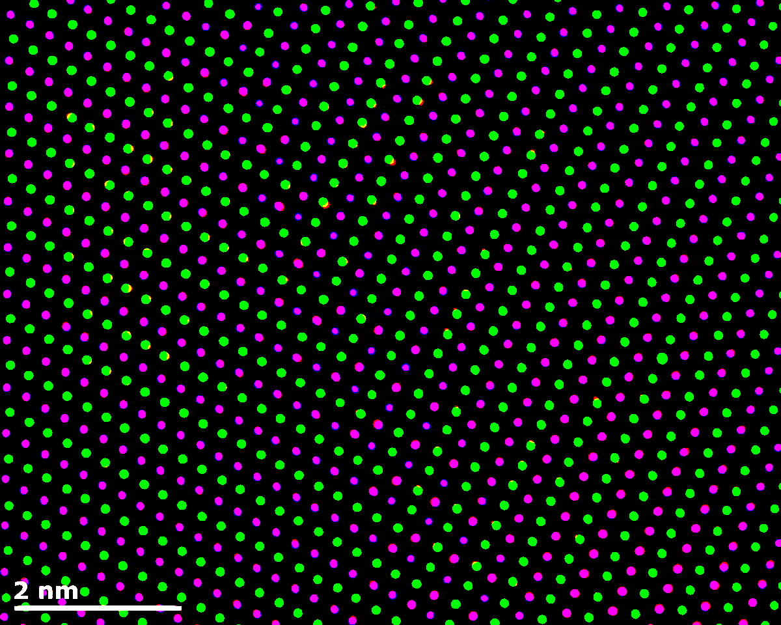
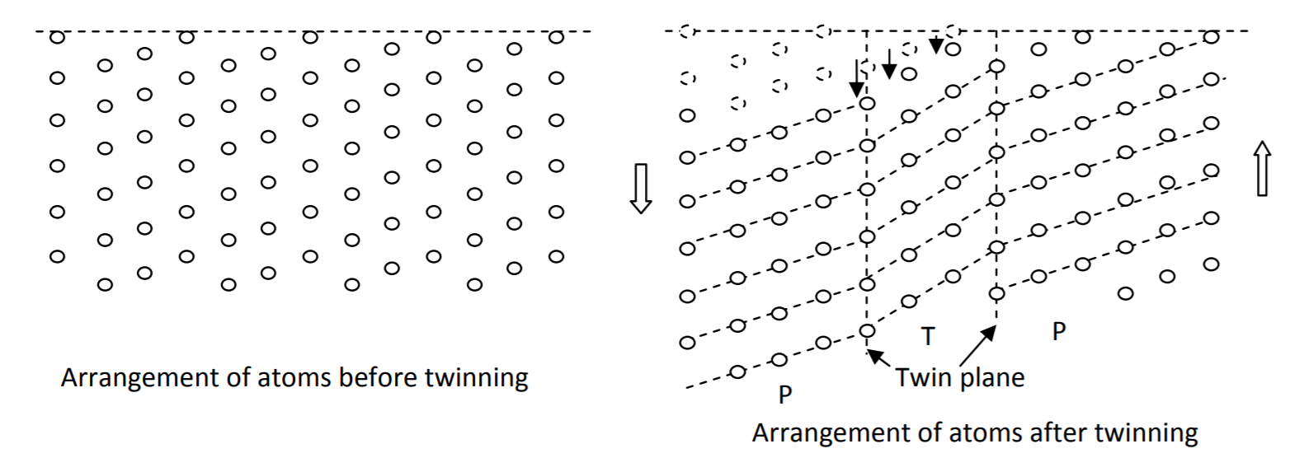
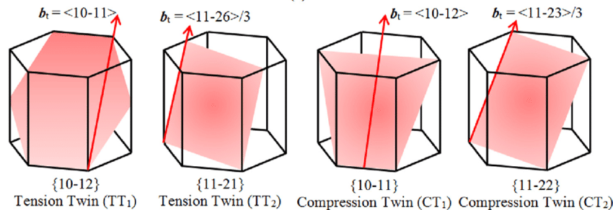
Twinning
Deformation twinning takes place to accommodate the strain
It occurs on a specific crystal plane in such a fashion that the deformed part becomes a mirror image of the parent crystal.
Among the twinning modes ET1 and ET2 twinning take place when c-axis is in tension while CT1 and CT2 operates when c-axis is in compression
ET1 ET2 CT1 CT2
Ref:
https://nptel.ac.in/courses/113105023/Lecture9.pdf

Slide 6
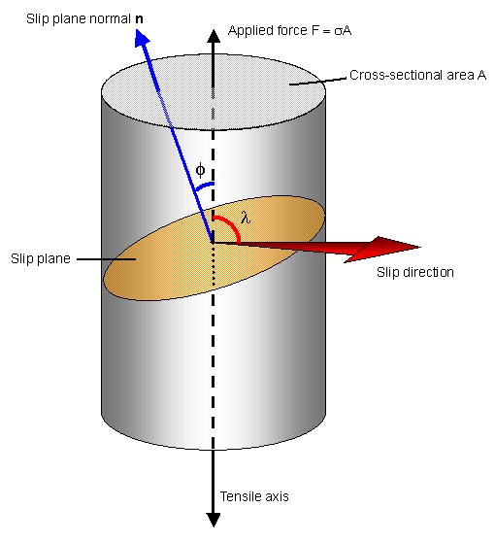

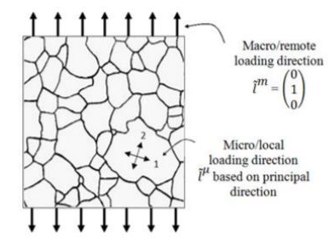
Schmid Factor
In a polycrystal containing 𝜂 grains, various slip systems in different grains may become active as the Critical Resolved Shear Stress is reached.
Angle between normal to slip plane and tensile axis = ϕ
Angle between slip direction and tensile axis = λ
Area of the slip plane inclined at angle ϕ = A/Cosϕ
Component of load acting in the slip plane in the slip direction = FCos λ
(Schmid Factor)
Yielding occurs when (Schmid’s Law):
Schematic diagram of a polycrystal sample under uniaxial tensile loading.
Ref:
https://spiral.imperial.ac.uk/bitstream/10044/1/34704/2/Acta%20Schmid%20Fatigue.pdf

Slide 7
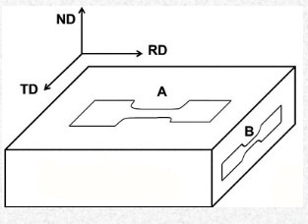
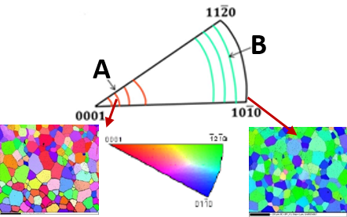
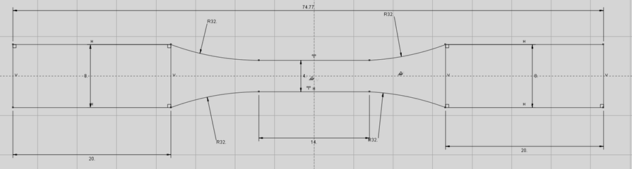
Sample Specifications
Cold rolled and annealed sheet of commercially pure grade 2 titanium machined in A and B orientations
Element | Ti | Fe | O | C | Others
Wt. % | 99.5 | 0.2 | 0.06 | 0.04 | 0.2
Orientation A – Near basal texture along the tensile axis
Orientation B – Near prismatic texture along the tensile axis
Uniaxial mechanical properties:
Orientation | 0.2% YS (MPa) | UTS (MPa) | % Elongation
A(//RD in RD-TD) | 262.5 ± 2.9 | 469.7 ± 12.5 | 43.7 ± 2.3
B(//TD in TD-ND) | 298.2 ± 5.7 | 448.7 ± 2.5 | 39.7 ± 0.9
Subhasis Sinha, Atasi Ghosh, N.P. Gurao, Effect of initial orientation on the tensile properties of commercially pure titanium, Philosophical Magazine 96 (2016) 1485-1508.

Slide 8
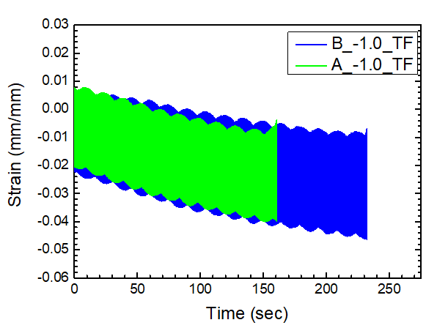
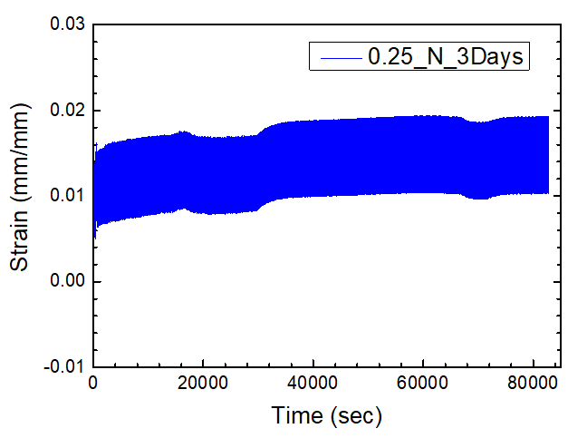
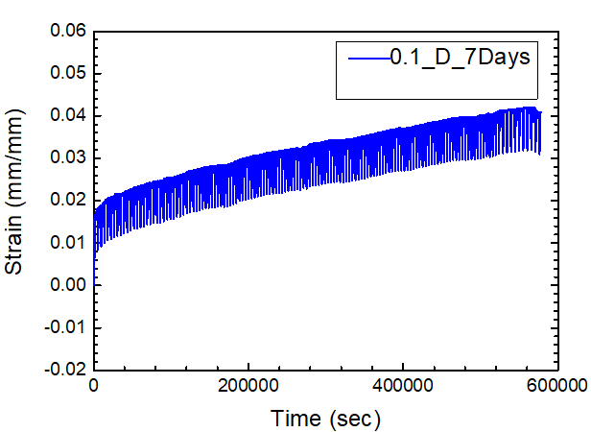
Strain-Time Plots
Sample Notation- B/A_R_TypeofTest_Days
B/A - Sample Orientation
R - R-Ratio Taken while Fatigue Loading
D - Dwell Fatigue
N - Normal Fatigue
TF- Till Fracture
Days - Number of Days for which the sample was tested.
Name of Sample | Number of Cycles
A_(-1.0)_TF | 1.092 x 10³
B_(-1.0)_TF | 1.224 x 10³
B_(0.25)_N_3days | 1.255 x 10⁶
B_(0.1)_D_7days | 4.741 x 10³
R-Ratio = -1.0
B-Oriented Sample lasts longer in comparison to A-Oriented Sample.
R-Ratio = 0.25 & 0.1
Strain in the sample reaches a saturation limit with time (or increasing cycle numbers).

Slide 9
A-fatigue Sample
FRACTOGRAPHY
Crack Initiation
Final Unstable Fracture
Striation

Slide 10
B-fatigue Sample
Less striation observed
More Ductile as compared to sample-A
More number of fatigue cycles
Crack Propagation
Crack Initiation
Final Unstable Fracture

Slide 11

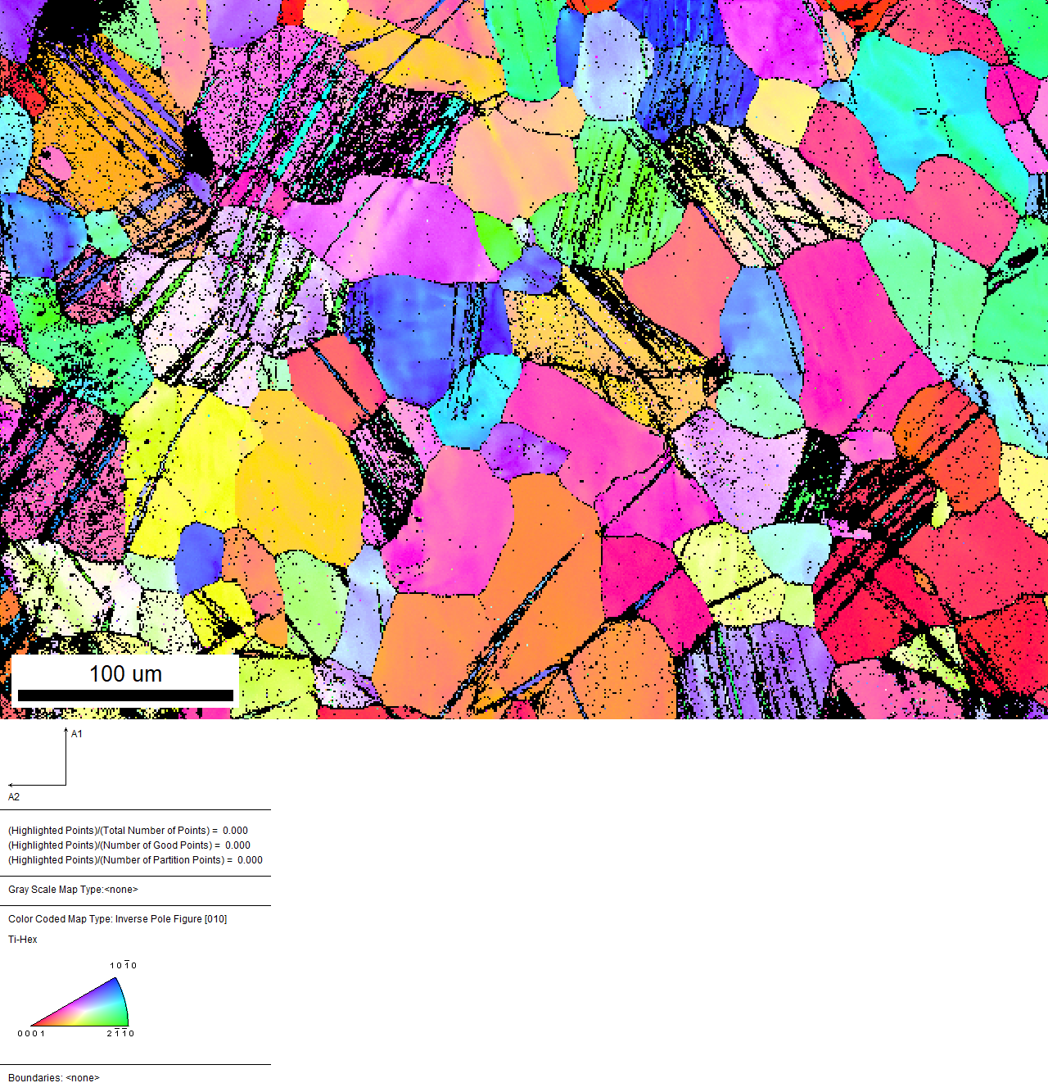
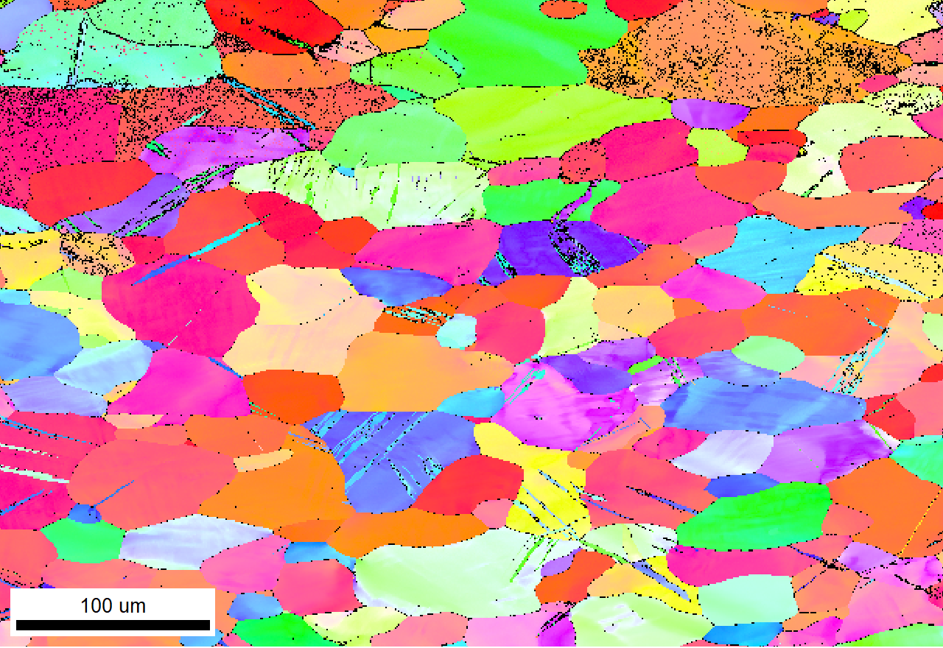


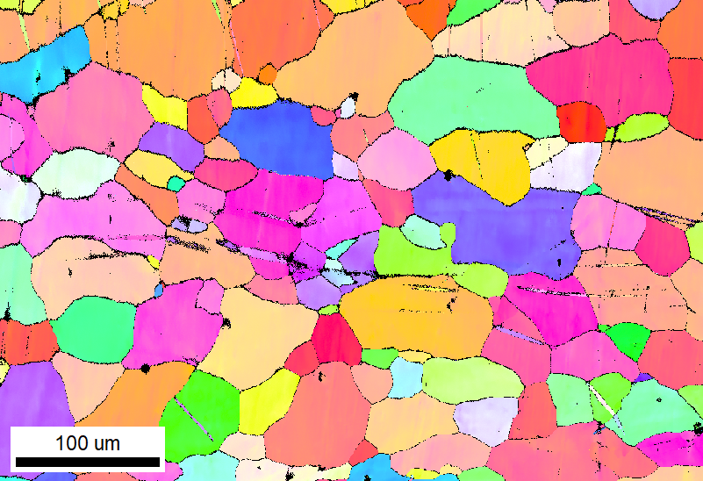
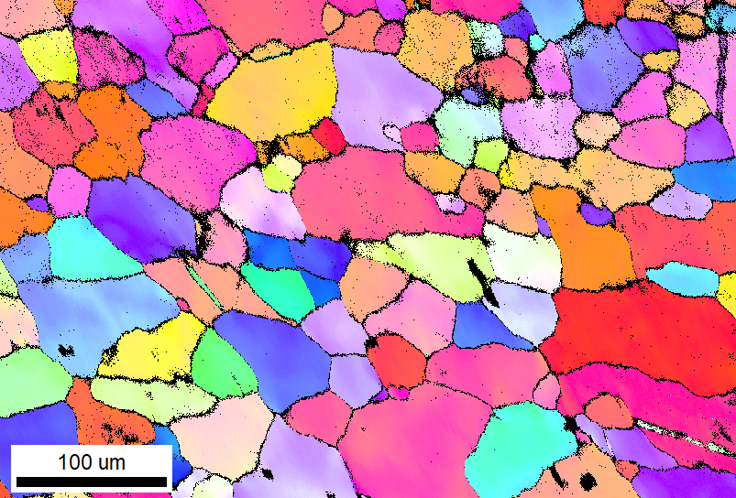
IPF Map along loading axis
A_(-1.0_TF
In the Inverse Pole Figure Map, colours indicate
various grain misorientations.

Slide 12

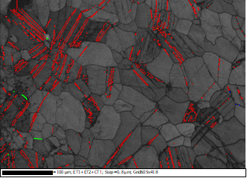
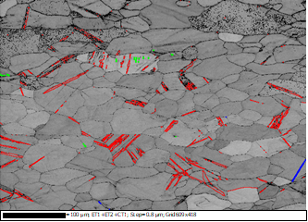
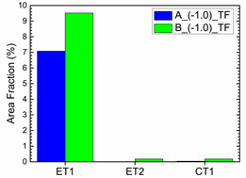
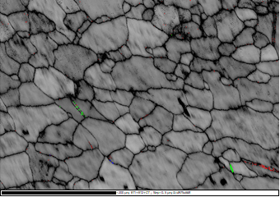
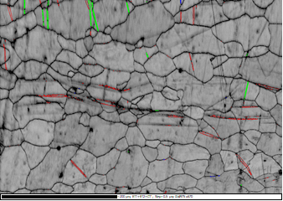
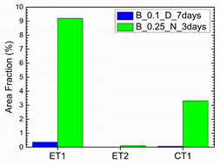
Twin Maps
Intersecting twins
• Parallel twins
• Higher grain density
• More twins in B than A
• Higher fraction of ET1
ET1
ET2
• Low twin formation in B
dwell
B_0.1_D_7days
CT1

Slide 13
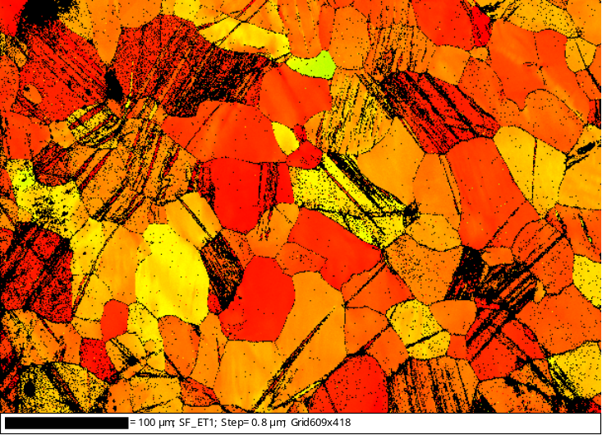
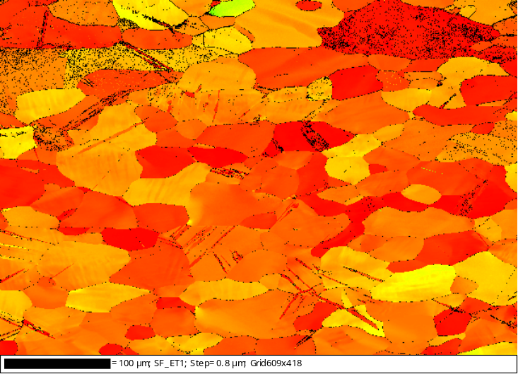
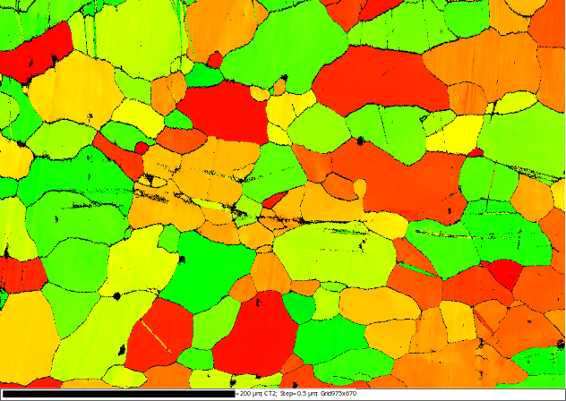
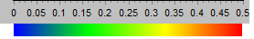
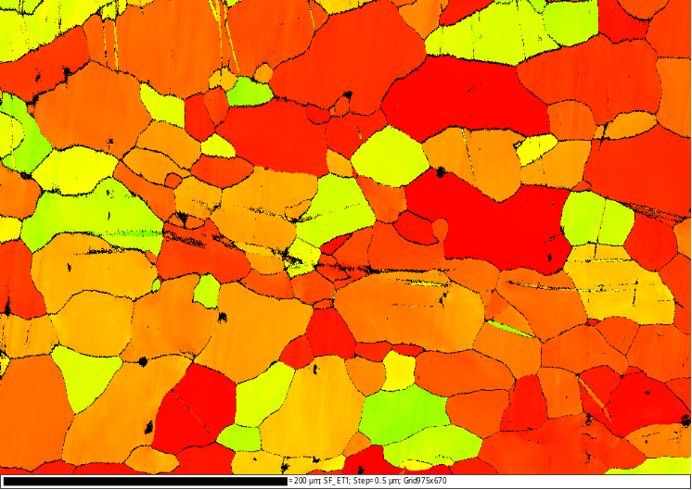
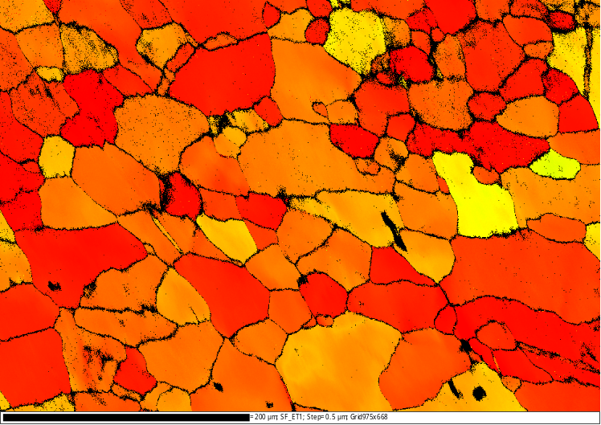
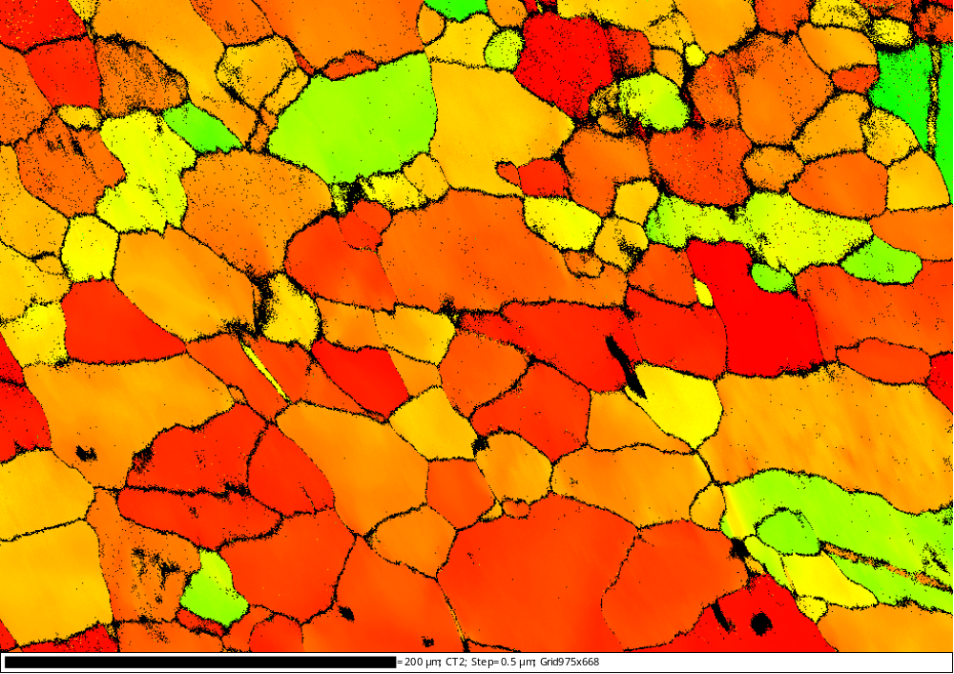
Schmid Map of ET1
ET1: Schmid behaviour in all cases
CT1: Non-Schmid behaviour
Schmid Map of CT1
Schmid Map of CT1

Slide 14
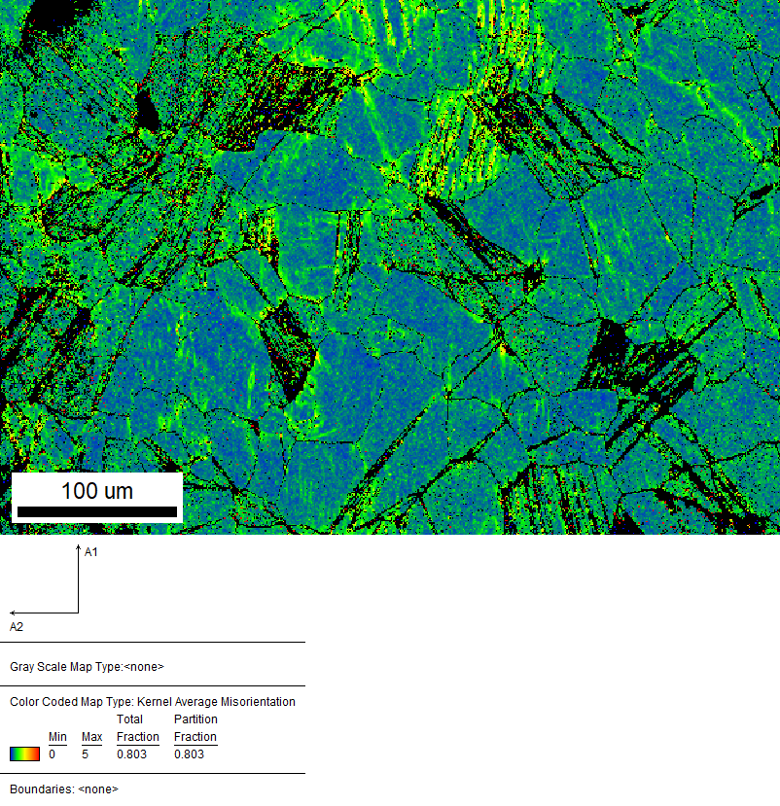
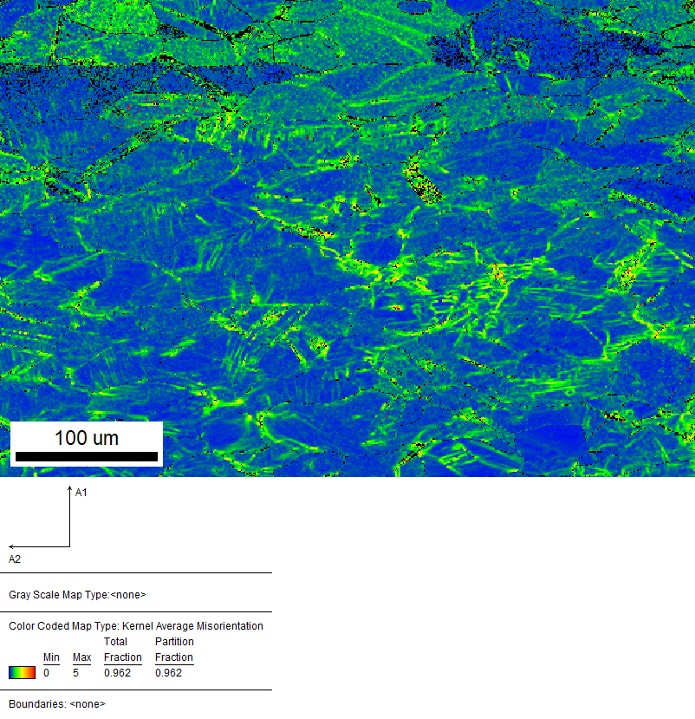
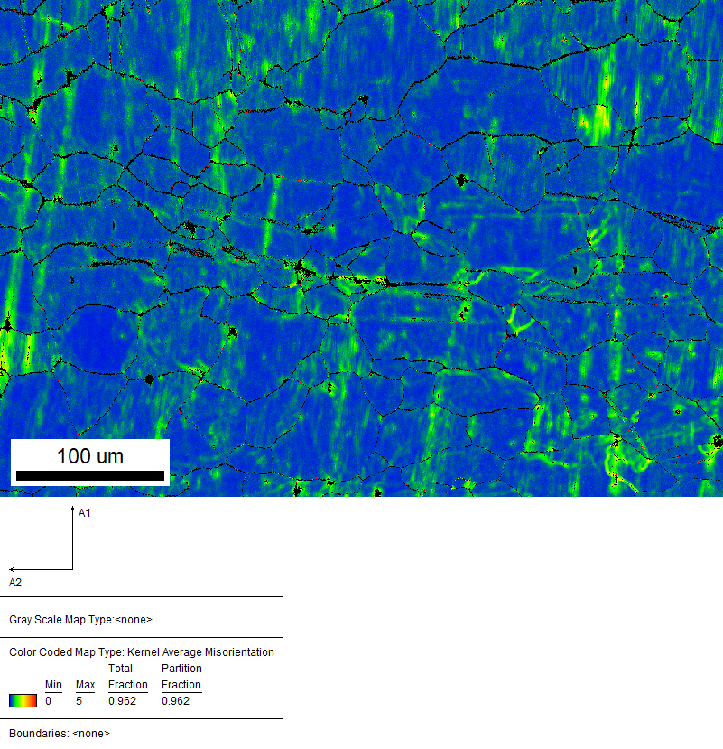
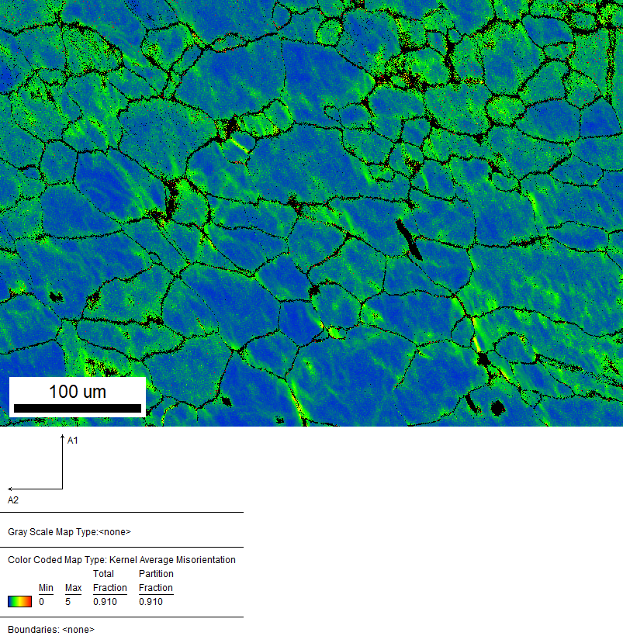
Kernel Average Misorientation (KAM)
High misorientation:
Twin
Grain boundaries
Average KAM value
B_(-1.0)_TF> A_(-1.0)_TF
Average KAM value
B_0.25_N_3days>B_0.1_D_7days
Red- maximum
Blue –minimum

Slide 15
Further Improvements
Optimisation of R-ratio for dwell fatigue testing of commercially pure titanium (Ti)
Investigating the effects of temperature during dwell fatigue testing on cp-titanium
Investigating the effects of other orientations other than A and B, and to compare their effects

Slide 16
THANK YOU
We would like to thank our instructor Prof. Nilesh Gurao sir for giving us this opportunity to express ourselves and make this lab course a memorable journey.
Besides this we would also like to thank Mr. Vivek Kumar Sahu sir for his valuable assistance in this project and all the staff members of MSE313A lab for their continuous support and guidance.
QUESTIONS ?

